Slide 1
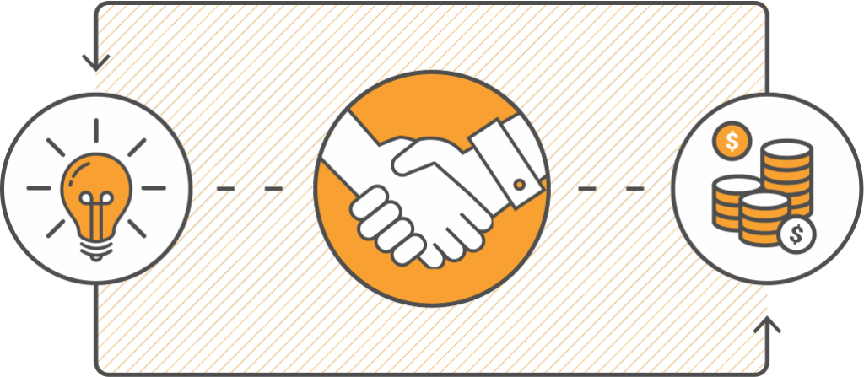
Introduction to USAID Grants
Facilitated by: Sheena Agarwal and Hamid Mehmood
August 26, 2016

Slide 2
Objectives
Familiarize participants with USAID grants
Discuss the types of grants and regulatory framework
Provide an overview of the grants lifecycle
Identify and discuss ethical considerations in grants management
Do a hands-on case study exercise to practice concepts

Slide 3
What you will learn
Regulations, standards, USAID vocabulary, grants framework
Compliance requirements
What a grant award cycle entails
How to complete some sections of a solicitation, and evaluate how well a submission aligns with an RFA (Request for Applications)

Slide 4
Introduction: Participants
Name
Organization
Your Role
Any USAID grant experience or other donors?

Slide 5
Agenda
8:30-9:00 | Introduction and Objectives
9:00-9:30 | Part I - Understanding the USAID grant framework
9:30-10:15 | Part II - Grant life cycle
10:15-10:30 | RFAs and Concept Papers - What to expect
10:30-10:45 | Tea/Coffee break
10:45-12:00 | Part III - Case Study/Group Exercise - Creating an activity plan and Gantt chart for a solicitation
12:00 - 12:30 | Discussion/Feedback on exercise
12:30 - 1:30 | Lunch
1:30 - 2:30 | Part IV - Internal Controls, Ethics and Standards of Business Conduct
2:30 - 3:45 | Part V - Case study/group exercise - Creating a budget for a solicitation
3:45-4:15 | Tea/Coffee break
4:15-5:00 | Discussion/Feedback on exercise
5:00 - 5:30 | Wrap up/Closing

Slide 6
Introduction: SERVIR-Mekong
USAID/NASA Partnership (2014-2019)
Goal: To enhance climate change adaptation and landscape management in the Lower Mekong region through the increased application of geospatial analysis to policy and planning needs
Consortium
Spatial Informatics Group
Stockholm Environment Institute
Deltares

Slide 7
SERVIR-Mekong Small Grants Program Launching: September 2016

Slide 8
Servir.adpc.net
Launching August 30th

Slide 9
What is USAID?
Mission Statement: USAID partners to end extreme poverty and promote resilient, democratic societies while advancing US security and prosperity.
USAID provides assistance in sub-Saharan Africa, Asia and the Near East, Latin America and the Caribbean, and Europe and Eurasia. With headquarters in Washington, D.C., USAID’s strength is its field offices in many regions of the world.
Notes:
→ We can ask: Has anyone heard of USAID? Worked with USAID in any capacity? <Show slide>
More info: The Agency operates in approximately 100 developing countries (the number varies from year to year), working closely with private voluntary organizations (PVOs), indigenous groups, universities, American businesses, international organizations, other governments, trade and professional associations, faith-based organizations, and other U.S. government agencies. Through contracts and grant agreements, USAID partners with more than 3,500 companies and over 300 U.S.-based PVOs.

Slide 10
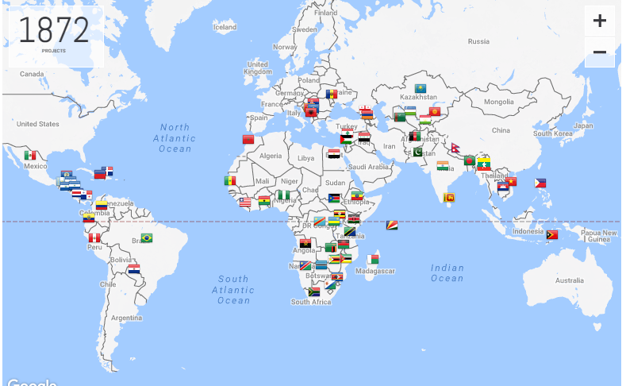
Where does USAID work?

Slide 11
What is a USAID grant?
Grants are financial assistance providing support or stimulation to accomplish a public (project) purpose, consistent with grantee’s mandate
Distinguishing Features:
Governed by specific set of regulations
Relationship is one of sponsorship
Should be performance-based
Often entails capacity building
Notes:
We’ll start with a very fundamental question - What is a grant?
<Show slide>
This is the US federal government definition of a grant. The key word here is assistance, which refers to the relationship between the grant maker and the recipient as one of sponsorship, as opposed to a buyer/seller relationship that characterizes acquisition.
These are general distinguishing features of a grant:
Grants are subject to different regulations than subcontracts, which we will go over later.
The relationship is one of sponsorship/partnership - a grant would involve the project funding an organization to undertake an activity that supports the organization’s purpose, which happens to also correspond to project objectives as well.
A grant is NOT a no-strings-attached gift – it can and should be performance based.
Since we operate in a developing country context, our grants typically serve to help build the capacity of the recipient.
For example: Project funds a Moldovan association of textile manufacturers to develop a directory of their members to help their members network among themselves. This also serves the project’s purpose of strengthening business development support organizations.
Other Examples:
Agribusiness -Helping producers’ comply with agricultural grades and standards to make their products exportable
Health - Funding local organizations’ roll out of proven service delivery models
Democracy and Governance - Funding local voter registration drives
Environment - Helping local tourism operators move toward “eco-tourism”

Slide 12
Types of Assistance
Difference between a Direct Grant and Grant Under Contract (GUC)
Main difference is a cooperative agreement may have substantial involvement on the part of USAID (ex. Approvals)
Grants
Cooperative Agreements
Contracts
Notes:
Can use SERVIR-Mekong/SERVIR Support as examples

Slide 13
Grant Types
Simplified
Fixed Award Amount
Standard
In-Kind
Notes:
Reiterate that we will reference this chart many times so participants become familiar with all grants

Slide 14
Grant Types
Simplified
Max $150,000 USD per grant, no limit on duration
Fixed Award Amount
Max $500,000/year, 3 years ($1.5m)
Standard
No max amount or duration
No max amount or duration
Advances or reimbursement
No international airfare (exceptions)
No indirect costs
Equipment only if necessary
No construction
Normally shorter duration
Fixed tranche payments upon achievement of milestones
Accomplishments clear and discernible
Low risk and management burden; Requires more up-front work
No construction
Advances or reimbursement
May include int’l travel, indirect costs
Increased grantee financial and reporting requirements --- high risk for project
No construction
In-Kind
Can be portion of any grant type, or 100% in-kind grant
Not an official grant type
Pre-award risk assessment required, but less extensive
No construction

Slide 15
Different types of payment methods
Simplified
Periodic reimbursements based on submission of receipts
Fixed Award Amount
Fixed amount tranche payments based on achievement of milestones (no receipts)
Standard
Periodic advances and/or reimbursements (receipts)
Direct Payment to Vendor
In-Kind

Slide 16
Eligibility Requirements
Applicants must be a registered organization
Demonstrate successful past performance in implementation
Display sound management in the form of financial, administrative, and technical policies and procedures and present a system of internal controls that safeguard assets
Government entities cannot receive direct financial compensation

Slide 17
USAID Regulatory Framework
Regulatory Framework
Statute (Law)
Foreign Assistance Act of 1961
Federal Grant and Cooperative Agreement Act of 1977
Administrative Rules and Regulations
22 CFR 200 (used to be OMB A-110, A-122, A-133)
22 CFR 226
USAID Policies & Procedures
ADS 303
Standard Provisions
Grant Agreement
Terms and conditions
Notes:
This diagram shows you where the USAID regulations come from in order of precedence. As we move from the top to the bottom, we arrive at the specific regulations and policies that you will need to know in order to manage USAID funds. I’ll go over this diagram briefly, and then we’ll take a closer look at the relevant regulations individually.
It starts with the United States laws: Federal Assistance Act of 1961 and the Federal Grant and Cooperative Agreement act of 1977. Both of these laws provide the US government with the authority to provide foreign assistance.
From these laws, the US government established government-level rules and regulations on foreign assistance. There are several – but what we are focusing on are the Office of Management and Budget Circulars and the Code of Federal Regulations.
From these USG-level regulations, we move down to USAID’s specific policies – which are based on the USG regs and laws. Again, there are many USAID policies, but what we will focus on are the Automated Directives Systems and its Standard Provisions.
Lastly, once you have a handle on the relevant USG level regulations and the USAID policies, you’ll need to read through your grant or cooperative agreement and understand the terms and conditions which you are legally held to.
A few things to keep in mind as we move forward into the details of the relevant regulations:
You do not need to memorize these regulations. The point is to understand which ones you need, what information they hold, and where to find them.
You will see that some of these regulations were written for US organizations. We’ll talk about which ones and why they are still applicable for non-US organizations.
Sometimes the regulations can be difficult to read through – this is the case for everyone. Do your best and, if ever have questions about the applicability of any regulation, don’t hesitate to get in touch with your AOR.
ADS 303 and Mandatory and Required as Applicable Standard Provisions are the main guidelines for USAID funded grants.
ADS 303 references 22 CFR 226 (Administration of Assistance Awards to U.S. Non-Governmental Recipients) and makes it applicable to Non U.S. organizations (ADS 303.3.1) with additional topics that ADS 303 doesn’t contain.
AAPD’s/CIB’s contain important amendments to the regulations and “update” the regulations though a major update of ADS 303 was done in January 2007 which incorporated many of these AAPDs/CIBs.
OMB Circulars A-122 and A-133 are referenced in the Standard Provisions.

Slide 18
ADS 303 - Grants and Cooperative Agreements to Non-Governmental Organizations
USAID specific policy
Provides comprehensive guide for grants programs
Provides a comprehensive guide for grants programs
Defines policies, procedures, and standards that USAID applies to its grant making activities
As a grantee, everyone must base their grants making on the guidance found in ADS 303
Notes:
go through the TOC and highlight important points:
Competition
Exception to competition
Types of grants
Certification
Review several key sections including types of grants, competition, certifications, etc.
Provides a comprehensive guide for grants programs
Defines policies, procedures, and standards that USAID applies to its grant making activities
As a grantee, everyone must base their grants making on the guidance found in ADS 303 and the accompanying Mandatory and Required as Applicable SPs.

Slide 19
Mandatory Standard Provisions
M1. Allowable Costs
M2. Accounting, Audit, and Records
M3. Amendment of Award and Revision of Budget
M4. Notices
M5. Procurement Policies
M6. USAID Eligibility Rules for Procurement of Commodities and Services
M7. Title To and Use of Property
M8. Development Experience Clearinghouse and Data Rights
M9. Public Communications
M10. Termination and Suspension
M11. Recipient and Employee Conduct
M12. Debarment and Suspension
M13. Disputes and Appeals
M14. Preventing Terrorist Financing
M15. Trafficking in Persons
M16. Voluntary Population Planning
M17. Equal Participation by Faith-Based Organizations
M18. Non-Discrimination
M19. USAID Disability Policy
M20. Limiting Construction Activities
Notes:
Why do we need these standards?
There are 20 standard provisions and depending on the type of grant, different provisions will be applicable
Pick a couple of these and review what they say

Slide 20
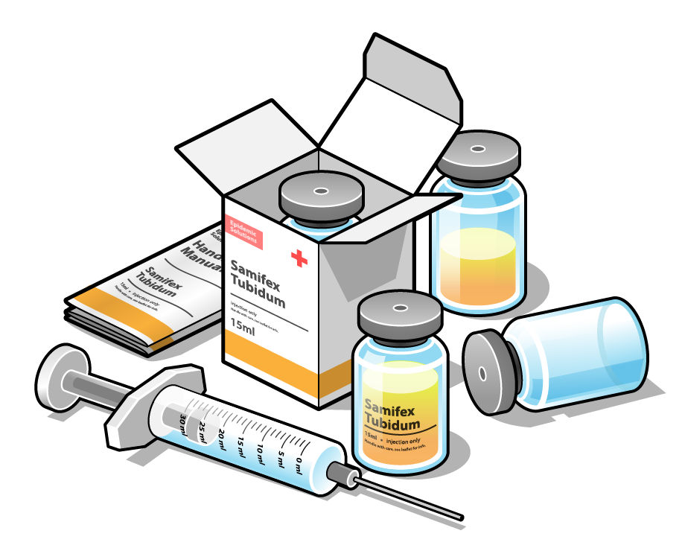
Unallowable Costs
Notes:
SERVIR grant funds may not be utilized for the following:
Construction or infrastructure activities of any kind.
Ceremonies, parties, celebrations, or “representation” expenses like a reception/banquet.
Purchases of restricted goods, such as: restricted agricultural commodities, motor vehicles including motorcycles, pharmaceuticals, medical equipment, contraceptive products, used equipment; without the previous approval of USAID, or prohibited goods, prohibited goods under USAID regulations, including but not limited to the following: abortion equipment and services, luxury goods, etc.
Alcoholic beverages.
Purchases of goods or services restricted or prohibited under the prevailing USAID source/ nationality regulations.
Any purchase or activity, which has already been made.
Purchases or activities unnecessary to accomplish grant purposes as determined by SERVIR.
Prior obligations of and/or, debts, fines, and penalties imposed on the Grantee.
Creation of endowments.

Slide 21
Grant funds may not be used for the following:
Construction or infrastructure activities of any kind.
Ceremonies, parties, celebrations, or “representation” expenses.
Purchases of restricted goods, such as: restricted agricultural commodities, motor vehicles including motorcycles, pharmaceuticals, medical equipment, contraceptive products, used equipment; without the previous approval of SERVIR, or prohibited goods, prohibited goods under USAID regulations, including but not limited to the following: abortion equipment and services, luxury goods, etc.
Alcoholic beverages.
Purchases of goods or services restricted or prohibited under the prevailing USAID source/ nationality regulations.
Any purchase or activity, which has already been made.
Purchases or activities unnecessary to accomplish grant purposes as determined by SERVIR.
Prior obligations of and/or, debts, fines, and penalties imposed on the Grantee.
Creation of endowments.

Slide 22
Part 2 Grants Lifecycle

Slide 23
Grants lifecycle
Solicitation
Evaluation
Pre-award Assessment
Award
Close-out
Implementation
Negotiations

Slide 24
Solicitation
What is included in a solicitation
Program description
Eligibility
Pre-award assessment for sound controls/financial ability/etc
Instructions
Award information (estimates on $ and timeline)
Regulations
Annexes
Notes:
Does anyone know the two types of solicitations? APS and RFA
Request For Applications (RFA): Used when an organization wants to support a specific activity. Response time must be at least 30 days
Annual Program Statements (APS): Used when an organization is seeking creative approaches to implement one or several activities
Open response time – closing date can be anywhere from 6 months to 1 year
The first step is to develop the solicitation. Usually this is done as a joint effort between the technical team (developing the terms of reference) and the grants manager (putting together the actual solicitation). You need to think about what type of grant the solicitation might result in. The solicitation might be an RFA—which means that we define the activity rather specifically, or an APS, which would be used if the project wants to get innovative ideas around a general subject area.
The solicitation is issued, and you may have a pre-proposal conference to explain to people the application process and answer questions.

Slide 25
Evaluation
Internal review by the project staff issuing the grant
Basic criteria will be established in the RFA/Concept Paper
Notes:
When the applications come in they are evaluated—usually by an internal review by project staff. Applications that need more work might be sent back to the applicant and the team might coach the applicant in improving the application. Once the applications are deemed to be complete and generally responsive by the grant manager they will usually be evaluated by a formal committee who will score the applications in writing against the established evaluation criteria.
As a best practice, USAID encourages competition in the selection process. However, in many instances, this isn’t the case for a variety of reasons (esp. OTI projects). When this happens, it is essential to justify restriction to eligibility (formerly called exception to competition) per ADS 303.3.6.5 and clearly explain via a memorandum of negotiation which must be included in the file.

Slide 26
Due Diligence
Conduct pre-award assessment
Verify costs
Negotiate final budget
Notes:
Before award, the grant manager has to do a risk assessment of the applicant – we’ll be talking about that more shortly. Once all these steps are taken the grant agreement is negotiated and signed. Depending on your grants manual and the value of the grant, USAID approval may be required. Some have mentioned that taking a picture of the signing ceremony is a good idea. The GM has to make sure the grantee understands all the terms of the agreement and associated requirements.

Slide 27
Negotiations
Negotiations on budget and terms
Sign required certifications
Notes:
Assuming the committee recommends award, the grant manager will negotiate the award, including getting required documentation from the applicant, such as some required certifications.
If USAID was not represented on the evaluation committee or you need to request formal approval that would be the next step.

Slide 28
Pre-Award Responsibility Determination Non-U.S. Organization Pre-Award Survey (NUPAS)
NUPAS Objectives:
Determine whether the organization has sufficient financial and managerial capacity to manage USAID funds in accordance with U.S. Government and USAID requirements
Determine the most appropriate method of financing
Determine the degree of support and oversight necessary to ensure proper accountability of funds
Capacity and risk areas to review :
Legal Structure
Financial management and internal control systems
Procurement systems
Human Resources
Project Performance Management
Notes:
The NUPAS is all encompassing and covers a lot of what was discussed today so I thought it would be a good idea to go over it as a review. If receiving USAID funds it is what you will be measured against. It is also general enough to be applicable to other donors.
Have the participants turn to the NUPAS in their resource guide

Slide 29
Award
Solicitation
Evaluation
Pre-award Assessment
Award
Close-out
Implementation
Negotiations
Important items to look for in your award
Signatures
Points of contact
Term of the activity
Objective of the activity
Reporting requirements/deadlines
Budget
Payment Terms
Special considerations – who is going to do the procurement, are there any specific approvals needed, branding and marking, termination clauses, etc.

Slide 30
Implementation
Understand your activity and follow your activity plan
Progress reports
Financial terms for payment based on type of grant
Project management
What to do if you cannot meet your deliverable or terms per your agreement
Procurements or activities are delayed
Mid-cycle modifications
M&E
Notes:
Then the grant is implemented and the grant manager and team do on-going oversight which normally would consist of site visits, reviewing deliverables, and documentation for disbursements. Monitoring may also include spot checking of the grantee’s financials or an audit. There may be a modification to the grant over time if circumstances change.

Slide 31
Closeout
Technical Closeout
Financial Closeout
Regulatory Closeout
Activities have been completed in accordance with the work plan/activity plan
Final reconciliation of any advanced funds or expenditures under the award submitted
Files and records have been properly maintained for audit purposes
Notes:
There is a formal process for closing out a grant when the grant period is over and/or when the activity has been completed. No grant can go beyond the end of the contract. It’s a good idea to have them wrap up a few months before the end of the contract so you can closeout the grant program and compile information about the impact of the program.

Slide 32
Grant Cycle Exercise
Work in groups to put the stages of a grant in the correct order

Slide 33
RFAs/Concept Papers
What does it mean to “be responsive” to a solicitation??
Notes:
See example RFA
You don’t want to be ineligible for a grant award because you didn’t follow the instructions.
Read your RFAs closely
Pay attention to the instructions and requirements
Sometimes a Concept Paper stage is included to shortlist candidates (2 weeks) – this helps both potential grantees and the awarding agency ensure that applicants are eligible and have ideas that respond adequately to the solicitation. Only shortlisted institutions will be invited to the full RFA (30 days)

Slide 34
Break: 15 min

Slide 35
Part III: Case Study/Group Exercise
Creating an activity plan and Gantt chart for a solicitation

Slide 36
Lunch: 1 hour

Slide 37
Part IV: Internal Controls, Ethics and Standards of Business Conduct

Slide 38
Ethics, Compliance and Internal Controls
Internal Controls/Segregation of duties
Standards of Business Conduct
Anti-Kickback
Conflict of Interest
False Claims Act
Employee Whistleblower Rights

Slide 39
What does internal controls mean?
Effective and efficient Operations
Reliable Financial Reporting
Compliance with terms, conditions and regulations
An organization’s management environment should have:
Notes:
In order to avoid ethical issues within your organization it is important to have internal controls.

Slide 40
Seven Essential Elements of Internal Controls
What are the seven essential elements of a good system of internal controls?
Competent Personnel
Fixed Responsibilities
Segregation of Duties
Safeguards Over Assets
Reliable Accounting System
Periodic Reporting
Monitoring
Notes:
Competent Personnel - Employees qualified and capable of doing the work are placed in positions which they can adequately fill; Employees are provided job-specific training commensurate with the requirements of their position; Employees are regularly evaluated and receive appropriate feedback on their performance.
Fixed Responsibilities Approval levels and thresholds for exercising authority to commit, bind, contract, purchase, receive, accept, dispose of, and pay for goods or services are formally defined and established for specific positions and individuals.
Segregation of duties – we will talk about that next.
Safeguards over assets: Safeguards over cash and other assets are in place to protect, preserve, or prevent their misuse. Safeguards over physical cash are very important because cash in hand is effectively impossible to trace once missing, it is easy to conceal and move, and theft can involve bodily harm.
Reliable accounting system: Accounting events are recorded accurately, in a consistent and timely manner, using an approved chart of accounts that conforms to budget line items in the award.
Periodic Reporting: At least monthly, management receives timely and accurate reports that are easy to understand that fully disclose the flow of funds through the organization/grant and the results of operations.
Monitoring: Annual audit is performed by a competent, independent certified public accountant; Findings of independent internal audits or reviews are provided directly to management and the board of directors; All recommendations (internal and external) are closed in a timely, competent manner.

Slide 41
Roles & Responsibilities
Grant Manager
Grant Finance staff
Grant Technical Staff

Slide 42
Segregation of Duties
Approver
Receiver
Payer
Notes:
you don’t want a system set up so that the accountant is the one receiving the invoice, reviewing it, approving it, issuing payment, and inserting it into the accounting system. You want a system that will classify expenses for what they are and are easy to track/review.
The functions of authorizing, ordering, receiving, accounting for, and paying for goods or services are not concentrated in any one individual.
Position descriptions segregate duties.
Policies and procedures restrict excessive concentration of duties.
A code of ethics clearly defines conflicts of interest and related party transactions.
Financial documents evidence processing, payment, review, and approval have been segregated within practical, effective limits.
Questions to consider when establishing the payment approval process include:
Who prepares the transaction after payment request has been received? (preparer)
Who reviews the payment request and supporting documentation? (reviewer)
Who approves the payment (signs the check, e-banking or mobile money payment order, or petty cash expense form)? (approver)
Who disburses payments? (disburser)
Who enters the transaction into accounting software? (data enterer)

Slide 43
Complete and Truthful Records
How can you do this?
Record work time, expenses for travel, materials, and quotes for goods and services completely and accurately.
Never alter or create financial documents such as receipts or invoices to conceal, exaggerate, or falsify information.

Slide 44
Example: Timesheets
You cannot submit and approve your own timesheet
Match your time to what you actually worked for the grant activity only (non-related work cannot be included in what you bill for your grant)
If you think you may exceed the budgeted hours, talk to the grant manager/donor BEFORE you incur the cost
Bill only up to 8 hours a day and 5 days a week
Notes:
With our grantees throughout the world we see the most common problems with timesheets. They are sometimes not taken seriously and completed quickly without attention to detail. You can never submit and approve your own timesheet!

Slide 45
Example: Fair and Healthy Competition
Take every measure to do excellent work and provide competent service.
Restrict doing business with companies that participate in anti-competitive business practices, such as:
A supplier submitting a fake bid, so its bid is the lowest
Companies colluding on prices, like taking turns submitting a low bid
A bid or offer from a company that does not exist

Slide 46
Standards of Business Conduct
Your organization should have formal standards (on paper) of conduct or other policies and practices that reflect your commitments to each other and your business partners.
It is required by USAID but it is also important to other donors
Creating a culture of honesty and respect
Being a reliable partner to your client and partners
Maintain accurate and transparent records and accounts
Avoid conflicts of interest
Think carefully before giving or accepting business favors
Promote fair and healthy competition
Notes:
Standards should make business expectations and commitments clear, to prevent misunderstanding between employees and/or between your organization and its beneficiaries including vendors and subawardees.
M11. RECIPIENT AND EMPLOYEE CONDUCT (AUGUST 2013)
a. The recipient must have written policies and procedures in place to prevent personal conflicts of interest and to prevent its officers, employees, or agents from using their positions for personal gain or presenting the appearance of a personal conflict of interest. A personal conflict of interest is a situation in which an officer, employee, or agent of the recipient has a financial interest, personal activity, or relationship that could impair the employee’s ability to act impartially when performing under the award. The recipient’s written policy must state that an employee, officer, or agent of the recipient, or any member of an employee’s immediate family cannot receive a subaward, or have a financial or other interest in the entity selected for a subaward without disclosing the conflict and following the recipient’s written policies and procedures for mitigating the conflict. In addition, the written policy must state that the officers, employees, and agents of the recipient must neither solicit nor accept gratuities, favors, or anything of monetary value from subrecipients or prospective subrecipients
(2) Any outside business dealings of the recipient’s employees must be legal and not conflict in any manner with this award. Outside business dealings include, but are not limited to, any investments, loans, employment, or business ownership by the recipient’s employees, other than work to be performed under this award.
e. In the event the conduct of any recipient employee is not in accordance with this provision or this award, the recipient must coordinate with the USAID Mission to resolve the situation with regard to such employee including, if necessary, termination of the employee. In the case of termination of a non-host country national, the recipient must use its best efforts to cause the return of such employee to the United States, or point of origin, as appropriate.

Slide 47
What types of things must be disclosed to a donor?
Any employment relationship (including self-employment) you maintain in addition to employment by the project.
Any outside business relationship or affiliation that may do business with the project or in your project’s country.
A financial or management interest in any company that provides goods or services to the project or that will be a project client.
WRITE THIS INTO YOUR POLICIES!!

Slide 48
Kickbacks
Accepting $ or gifts from current or future vendors
Notes:
Does anyone know what a kickback is?
Offering, providing, soliciting, or accepting any money, fee, commission, credit, gift, gratuity, in-kind contribution, object of value, or compensation to improperly obtain or reward favorable treatment on government contract, subcontract, or grant, is called a kickback and is a crime when working with the USG

Slide 49
Kickback Case Studies
Are these cases okay?
A vendor provides your staff member with a laptop as a gift after receiving a quotation.
A subawardee asks a vendor for payment in order for vendor to be awarded the bid.
Using a recurring hotel and the hotel provides a voucher during the holiday season as a gift.

Slide 50
Conflict of Interest
When an employee is in a position where their personal or professional interests interfere with their objective decision making for the institution
If this is the case, you must openly acknowledge and report these conflicting interests

Slide 51
Examples of Conflicts of Interest
Recommending vendors that are related to you and not informing management in your organization
Hiring/ supervising relatives and friends
Steering project activities so that you or your family benefit
Staff members being friends with a vendor who is competitively bidding on work from the organization
Notes:
Also, keep in mind that just because there is a conflict of interest, doesn’t necessary mean that the activity cannot go forward. In many cases, we can put in place steps to mitigate against the conflict of interest. For example, if you have an uncle who has a restaurant that can provide food for a training. Let us know about this relationship. It doesn’t mean that we can’t use your uncles restaurant. What we need to do is to obtain three quotations, it can include your uncle, and if your uncle is the most competitive, he may end up getting the business. But it cannot be you that collects the quotations and cannot be involved in any of the discussions. The trick is that we need to be informed about the potential conflict before the activity takes place.

Slide 52
Ethics: False Claims
Submitting an invoice that violates a grant agreement’s source
Submitting false vendor invoices or expenses
Inaccurate certifications used to obtain a grant
Double billing expenses with multiple donors

Slide 53
Part V - Case Study: Budget Exercise

Slide 54
Break: 30 min

Slide 55
Budget discussion/evaluations

Slide 56
Wrap-up/Closing

